Slide 1

Exponential and Logarithmic Functions
CSM PRESS 2025

Slide 2
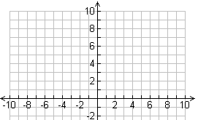

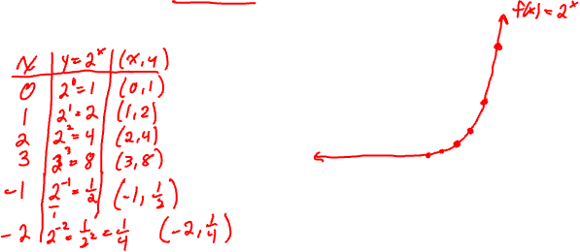
Exponential Functions
Functions of the form $f(x)=b^{x}$ , where the base $b$ is a constant such that $b>0$ and $b≠1$, and $x$ is any real number.
Example: Graph $y=2^{x}$.

Slide 3
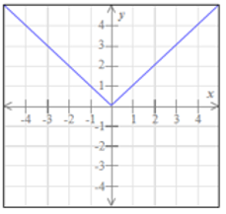
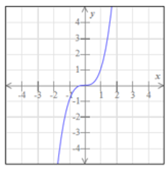
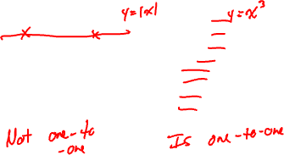
One-to-One Functions
A function is said to be one-to-one if each number in the range is associated with exactly one number in its domain.
Graphically, these types of functions will pass the Horizontal Line Test (any horizontal line drawn will intersect the function’s graph at most once).

Slide 4
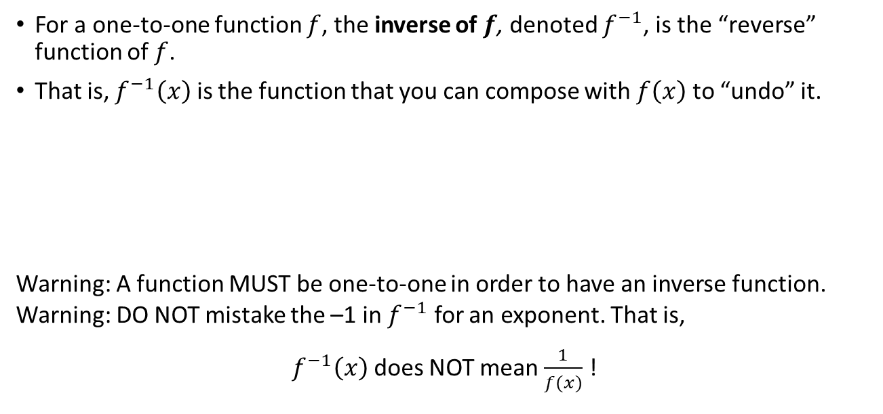
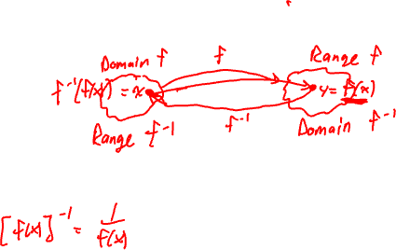
Inverse Functions
For a one-to-one function $f$, the inverse of $f$, denoted $f^{−1}$, is the “reverse” function of $f$.
That is, $f^{−1}\left(x\right)$ is the function that you can compose with $f\left(x\right)$ to “undo” it.
Warning: A function MUST be one-to-one in order to have an inverse function.
Warning: DO NOT mistake the –1 in $f^{−1}$ for an exponent. That is,
$f^{−1}\left(x\right)$ does NOT mean $\frac{1}{f(x)}$ !

Slide 5
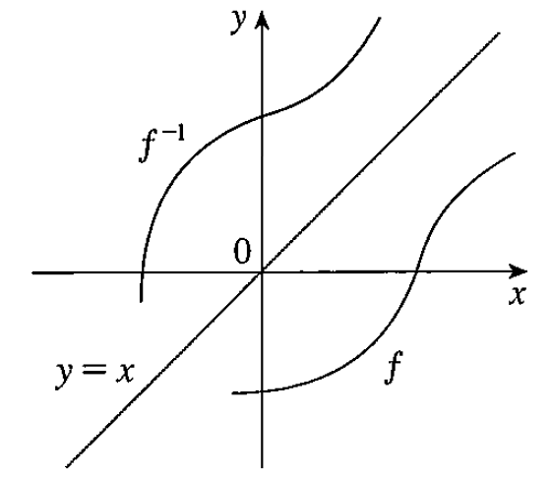
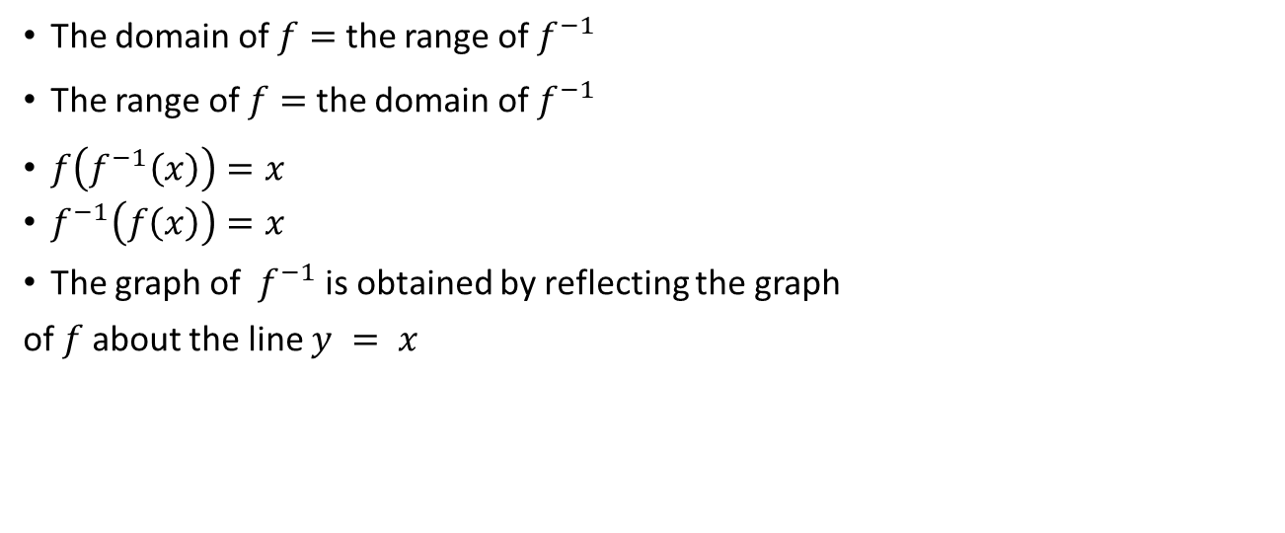

Inverse Function Properties
The domain of $f=$ the range of $f^{−1}$
The range of $f=$ the domain of $f^{−1}$
$f\left(f^{−1}\left(x\right)\right)=x$
$f^{−1}\left(f\left(x\right)\right)=x$
The graph of $f^{−1}$ is obtained by reflecting the graph
of $f$about the line $y = x$

Slide 6
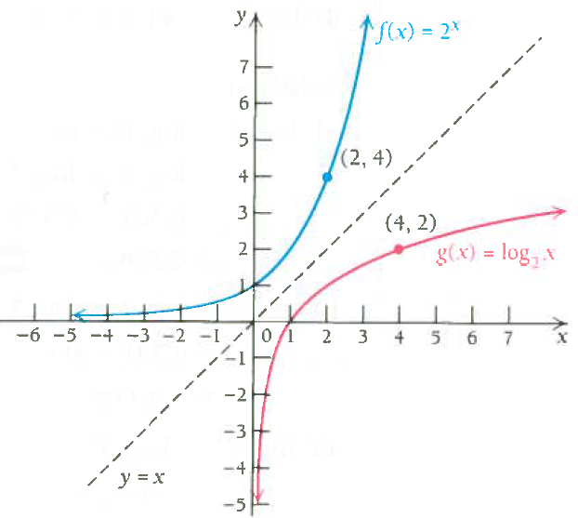
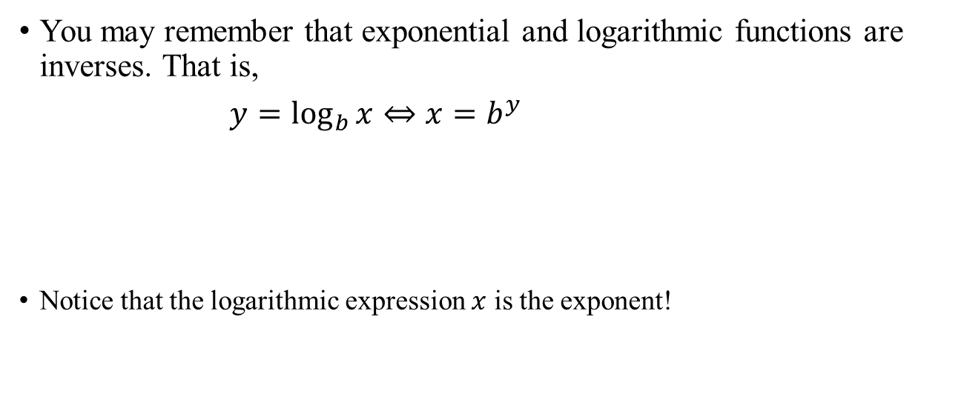

Exponential and Logarithmic Functions
You may remember that exponential and logarithmic functions are inverses. That is,
$y=\log_{b}{x}⇔x=b^{y}$
Notice that the logarithmic expression $x$ is the exponent!

Slide 7
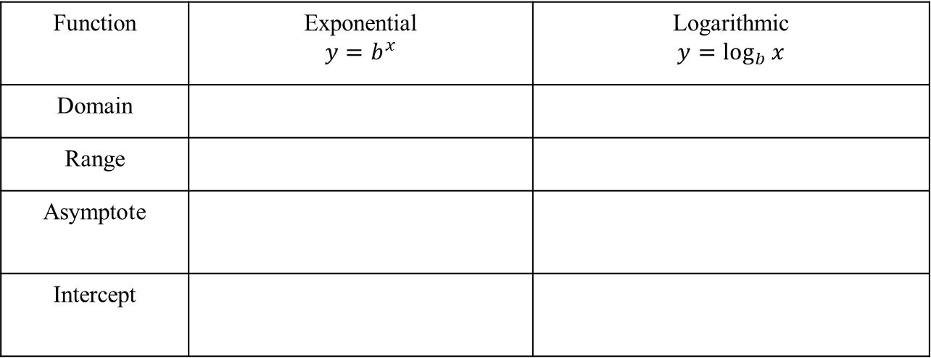
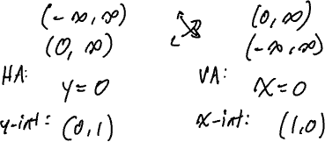
Domain and Range
Function | Exponential $$y=b^{x}$$ | Logarithmic $$y=\log_{b}{x}$$
Domain
Range
Asymptote
Intercept

Slide 8
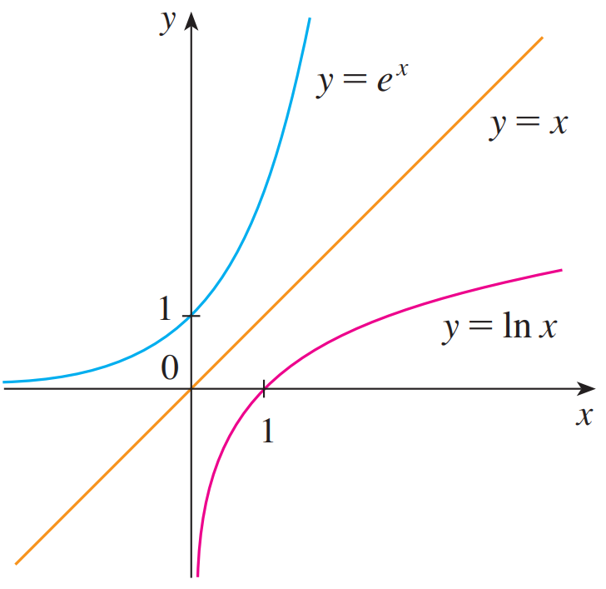

Special Bases
Euler’s Number: $e$ is an irrational number (like $π$, it is NOT a variable).
$$e≈2.71828182846$$
We call the function $f\left(x\right)=e^{x}$ the natural exponential function.
We call the function $f\left(x\right)=\log_{e}{x}=\ln{x}$ the natural logarithm function.

Slide 9
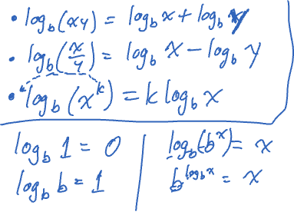
Properties Of LOGARITHMIC FUNCTIONS

Slide 10

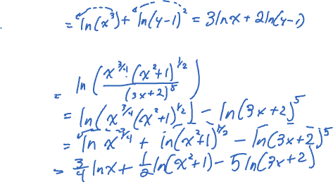
Examples
Expand each expression.
a. $\ln\left(x^{3}{\left(y−1\right)}^{2}\right)$
b.$\ln\left(\frac{x^{3/4}\sqrt{x^{2}+1}}{{(3x+2)}^{5}}\right)$

